Slide 1
Image Coordinate System (ICS) Basics
Notes:
Esri Corporate Template-Dark v3.4
16:9 version – January 29, 2017
For more templates, sample files, and icons, see https://compass.esri.com/resources/presentations/Pages/Main.aspx
To add footer text in Windows
On the Home tab, under Insert, click Text, and then click Header and Footer.
Click the Slide tab, select the Footer check box, and then type the footer text that you want.
Click either Apply or Apply to All.
To add footer text on a Mac
On the View menu, select Header and Footer.
Select the Footer check box and then type the footer text that you want.
Click either Apply or Apply to All.
If footers don't appear on the slides
If footers don't appear on title slides, in the Header and Footer dialog box make sure the Don't show on title slide check box is not selected.
If the footers are missing from other slides, the placeholders for these items might have been removed from specific slide layouts or the slide master.

Slide 2
ICS is for Oblique Imagery
For vertical imagery it is acceptable to bring the image to the map
For oblique imagery you want to bring the map to the image
Oblique imagery distorts badly when you orthorectify it
The image in the ICS is referred to as the “focus image”
Vector data will easily transform to the focus image
Other imagery will transform into the focus image geometry, but be distorted

Slide 3
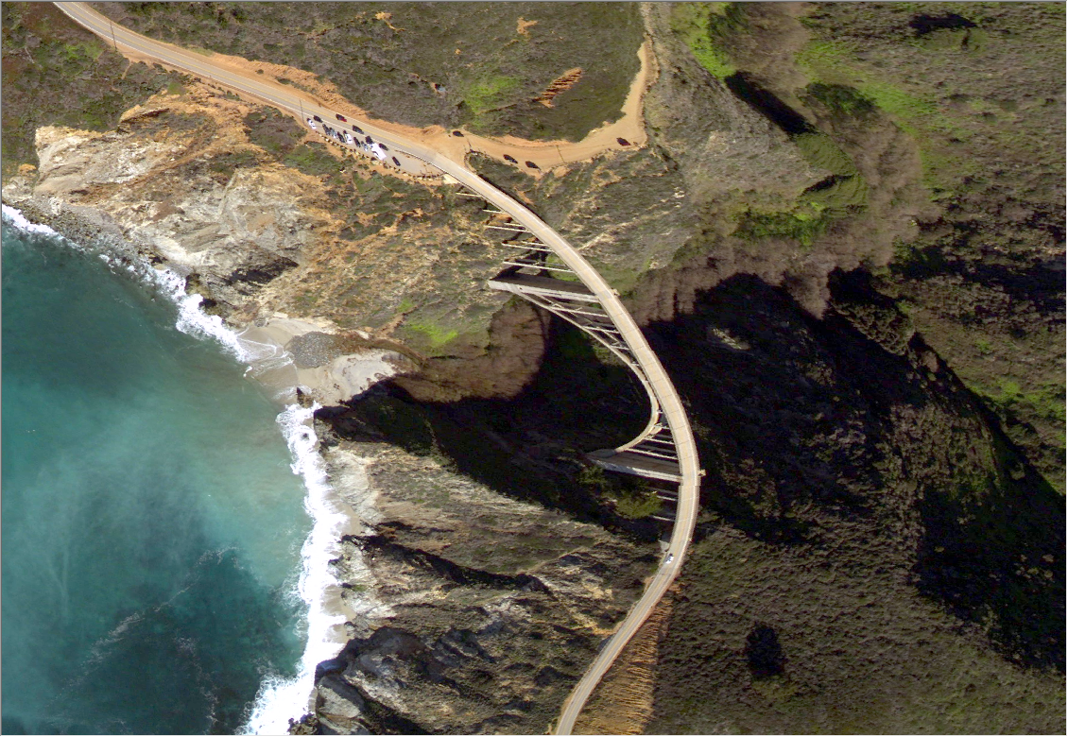
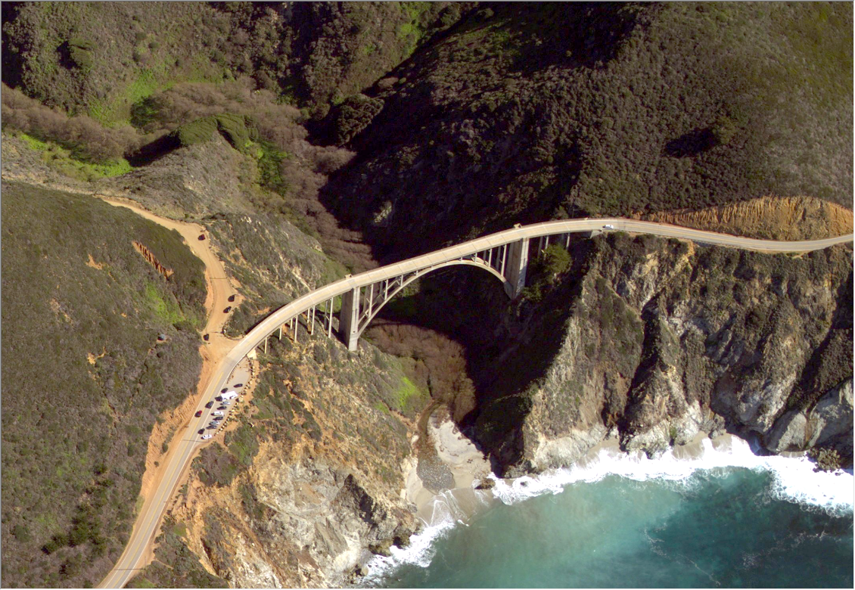
Image Space
Map Space
Capabilities
Image space
Move between Image Space and Map Space
Align feature data and other imagery
Edit in Image Space
ICS
Image Space
Ground to image
Ground to image
3D (requires DEM)
3D (requires DEM)
Image to Ground
Xform
libraries
Image to Ground
GCS
PCS
2D

Slide 4
Image-Map layer geometric relationships
Feature item
Image in ICS
Obscured area
Elevation data in ICS
Elevation in GCS or PCS
Ortho image in GCS or PCS
Feature layers in GCS or PCS

Slide 5
Elevation references
Extremely Small Scale
Deflection of the vertical
Terrain Surface
(Bare earth)
Geoid
Ellipsoid
Ellipsoidal height
Orthometric height
Different sensors and applications use different references
Ellipsoidal – GPS
Orthometric – Survey
Above Ground level - feature height, airborne navigation

